Slide 1
Interaksi Manusia dan Komputer (IMK)
THE USER INTERFACE (UI) DESIGN PROCESS
Step 1 : Know Your Users & Clients

Slide 2
Tujuan
Setelah mengikuti materi ini mahasiswa dapat:
Memahami pentingnya mengenal pengguna dari aplikasi yang akan dibangun sebagai dasar untuk merancang antarmuka perangkat lunak
Mendefinisikan Persona User antarmuka perangkat lunak

Slide 3
Outline
What is Persona?
Why Personas are important in design?
How to define Persona
Know Your Users
How to gather user data
Template Persona

Slide 4
WHAT IS PERSONA?

Slide 5
What is Persona http://webdesign.tutsplus.com/articles/defining-and-applying-personas-to-ux-design--webdesign-7561
Adapun output dari step 1 ini adalah menghasilkan Persona User
In terms of web design, a persona is a fictional example of a person within your user base. It typically includes details such as
age
sex
occupation
hobbies
likes/dislikes
other details germane to the product
Many times it also includes the personalities of these fictional users. The goal of erecting these details is to establish the mindset, desires, and necessary tasks of your users. Ideally, the persona creation process is informed by research and/or an intimate knowledge of an established user base. How you design them and what information you include is up to you and what you need

Slide 6
WHY PERSONA IS IMPORTANT IN UI DESIGN PROCESS?

Slide 7
Why Persona?
Persona User dibuat untuk :
Help identify specific users and needs
Identify primary, secondary users
Helps choose the right individuals to design for

Slide 8
OVERVIEW HOW TO DEFINE PERSONA?

Slide 9
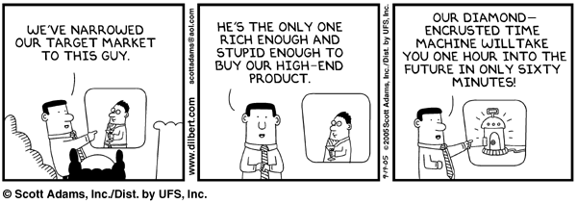
Target users

Slide 10
Tahapan untuk dapat mendefinisikan Persona (User)
Kunjungi lokasi pengguna, terutama jika tempat kerja pengguna yang tidak familiar untuk kita. Hal ini untuk menuntun kita mengetahui lingkungan kerja pengguna.
Berbicaralah dengan para pengguna untuk mengetahui apa masalah mereka, kesulitan, harapan serta apa yang membuat mereka nyaman saat ini.
Membangun komunikasi secara langsung dengan pengguna. Hindari perantara.
Melakukan observasi bagaimana cara mereka melakukan setiap task serta melihat apa kesulitan dan masalah mereka.
Merekam cara kerja pengguna dalam melakukan task dan mempelajari masalah dan kesulitannya.
Mempelajari bagaimana sebuah alur kerja dalam lingkungan dimana sistem akan diinstal.
Apakah pengguna berpikir keras ketika mereka melakukan sesuatu untuk mengungkap rincian yang tidak mungkin dan hal lain yang dapat dilakukan.
Cobalah sendiri melakukan kegiatan pengguna.
Melakukan survey dan kuesioner untuk mendapatkan sampel pengguna.
Buat sebuah tools/alat untuk dapat menggali perilaku user dalam mencapai tujuannya, kemudian ukur sampai dengan kebutuhannya tercapai.

Slide 11
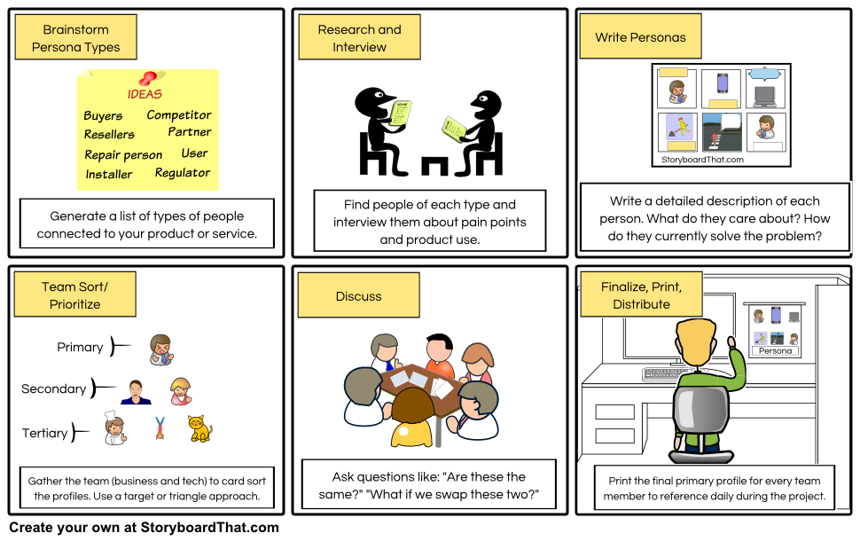
Steps to Create Personas

Slide 12
KNOW USERS

Slide 13
Step 1 : Know your users and clients
Understand how people interact with computers.
Understand the human characteristics important in design.
Identify the user’s level of knowledge and experience.
Identify the characteristics of the user’s needs, tasks, and jobs.
Identify the user’s psychological characteristics.
Identify the user’s physical characteristics.
Employ recommended methods for gaining understanding of users.

Slide 14
Understand how people interact with computers
Siklus aksi manusia :
Tujuan dibentuk
Sebuah rencana eksekusi disusun dan diimplementasikan
Hasil dari sebuah tindakan kemudian dievaluasi
Mengapa orang memiliki masalah dengan komputer
Terlalu banyak flesibilitas
Menggunakan jargon
Desain yang membingungkan/tidak jelas
Perbedaan yang terlalu halus
Disparitas dalam strategi pemecahan masalah

Slide 15
Understand the human characteristics important in design
Respon psikologis yang khas untuk desain buruk adalah: Kebingungan, Annoyance, Frustrasi, Panic / stres, Kebosanan.
Kemudian akan diikuti dengan reaksi fisik :
Pengabaian sistem.
Penggunaan sebagian dari sistem.
Penggunaan langsung dari sistem.
Modifikasi tugas.
Aktivitas kompensasi.
Penyalahgunaan sistem.
Pemrograman langsung

Slide 16
Understand the human characteristics important in design
Perception
Memory : Short term memory (STM) dan Long term memory (LTM)
Sensory storage
Visual Acuity
Information Process
Mental Models
Movement Control
Learning
Skill
Performance Load
Individual Differences

Slide 17
Understand the human characteristics important in design
Faktor penentu utama untuk merancang sistem interaktif
Pemahaman bagaimana orang berpikir, belajar dan berkomunikasi
Bisa dianalogikan dengan model pemrosesan dalam komputer

Slide 18
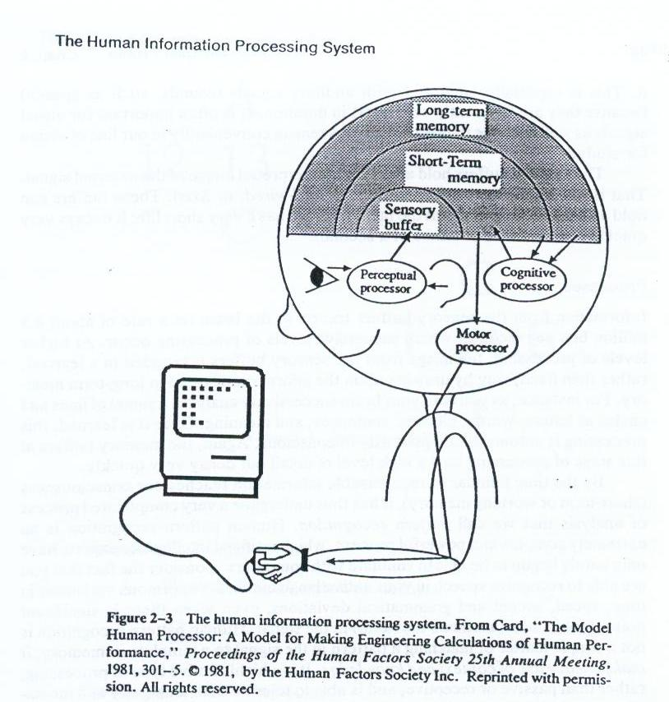
3 Phase Human Information Processing System
Perceptual System (Read – scan)
Cognitive System (Think)
Motor System (Response)

Slide 19
Perceptual System
Memory Structure :
Sensory organ → sensory buffer to hold a virtual, uninterpreted image of external signal
Can hold a high level of detail, but a very short in duration
Information will decay or travel to brain

Slide 20
Perceptual Process
Image from sensory buffer is recorded in a learned way by drawing upon the information store in long-term memory
Human Pattern Recognition is not a simple matter of matching a pattern it makes heavy use of context and knowledge
Human Pattern Recognition is a active processing, able to tolerate an ambiguity and incompleteness information.

Slide 21
Cognitive System
Short-term Memory (STM) :
Not only a storage buffer but also a (very slow) processor
Limited in Capacity and Duration
Long Term Memory (LTM) :
Unlimited in Capacity and permanent duration
Request effort & concentration to put new information in LTM

Slide 22
Motor System
It is believe that thought is translated into action through a series of discrete micromovement
Motor movement relevant to UI design include :
head, eye, arm, hand and finger movement

Slide 23
Human Considerations in the Design of Business Systems
The User’s Knowledge and Experience
The User’s Tasks and Needs
The User’s Psychological Characteristics
The User’s Physical Characteristics

Slide 24
Identify the user’s level of knowledge and experience
KNOWLEDGE/EXPERIENCE
Computer Literacy | Highly technical or experienced, moderate computer experience, or none.
System Experience | High, moderate, or low knowledge of a particular system and its methods of interaction.
Application Experience | High, moderate, or low knowledge of similar systems.
Task Experience | Level of knowledge of job and job tasks.
Other Systems Use | Frequent or infrequent use of other systems in doing job.
Education | High school, college, or advanced degree.
Reading Level | Less than 5th grade, 5th–12th, more than 12th grade.
Typing Skill | Expert (135 WPM), skilled (90 WPM), good (55 WPM), average (40 WPM), or “hunt and peck” (10 WPM).
Native Language or Culture | English, another, or several.

Slide 25
Identify the characteristics of the user’s needs, tasks, and jobs
JOB / TASK / NEED
Type of System Use | Mandatory or discretionary use of the system.
Frequency of Use | Continual, frequent, occasional, or once-in-a-lifetime use of system.
Task or Need Importance | High, moderate, or low importance of the task being performed.
Task Structure | Repetitiveness or predictability of tasks being automated, high, moderate, or low.
Social Interactions | Verbal communication with another person required/not required.
Primary Training | Extensive or formal training, self-training through manuals, or no training.
Turnover Rate | High, moderate, or low turnover rate for jobholders.
Job Category | Executive, manager, professional, secretary, clerk.
Lifestyle | For Web e-commerce systems, includes hobbies, recreational pursuits, and economic status.

Slide 26
Identify the user’s psychological characteristics
PSYCHOLOGICAL CHARACTERISTICS
Attitude | Positive, neutral, or negative feeling toward job or system.
Motivation | Low, moderate, or high due to interest or fear.
Patience | Patience or impatience expected in accomplishing goal.
Expectations | Kinds and reasonableness.
Stress Level | High, some, or no stress generally resulting from task performance.
Cognitive Style | Verbal or spatial, analytic or intuitive, concrete or abstract.

Slide 27
Identify the user’s physical characteristics
PHYSICAL CHARACTERISTICS
Age | Young, middle aged, or elderly.
Gender | Male or female.
Handedness | Left, right, or ambidextrous.
Disabilities | Blind, defective vision, deafness, motor handicap.

Slide 28
HOW TO GATHER DATA PERSONA?

Slide 29
Brief overview of common methods to gather user data
Interviews
Questionnaires
Observation
Choosing and combining techniques

Slide 30
Interviews
Unstructured - are not directed by a script. Rich but not replicable.
Structured - are tightly scripted, a questionnaire delivered verbally. Replicable but may lack richness.
Semi-structured - guided by a script but interesting issues can be explored in more depth. Can provide a good balance between richness and replicability.

Slide 31
Interview questions
Two types:
‘closed questions’ have a predetermined answer format, e.g., ‘yes’ or ‘no’
‘open questions’ do not have a predetermined format
Closed questions are easier to analyze
Avoid:
Long questions
Compound sentences - split them into two
Jargon and language that the interviewee may not understand
Leading questions that make assumptions e.g., why do you like …?
Unconscious biases e.g., gender stereotypes

Slide 32
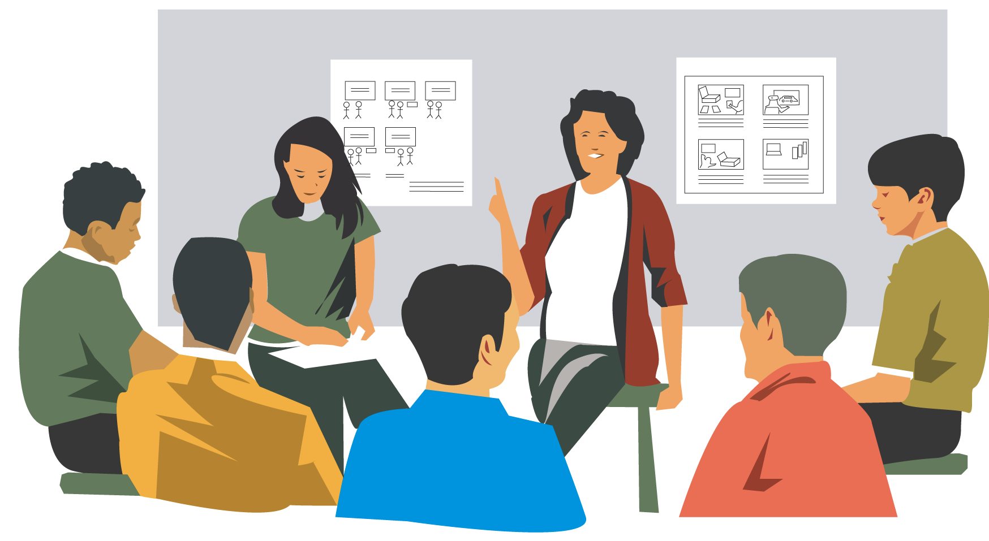
Enriching the interview process
Props - devices for prompting interviewee, e.g., a prototype, scenario

Slide 33
Contextual Inquiry
An approach to ethnographic study. Often conducted as an apprenticeship where user is expert, designer is apprentice
A form of interview, but
at users’ workplace (workstation)
2 to 3 hours long
Four main principles:
Context: see workplace & what happens
Partnership: user and developer collaborate
Interpretation: observations interpreted by user and developer together
Focus: project focus to understand what to look for

Slide 34
Questionnaires
Questions can be closed or open
Closed questions are easier to analyze, and may be done by computer
Can be administered to large populations
Paper, email and the web used for dissemination
Sampling can be a problem when the size of a population is unknown as is common online

Slide 35
Questionnaire design
The impact of a question can be influenced by question order.
Do you need different versions of the questionnaire for different populations?
Provide clear instructions on how to complete the questionnaire.
Strike a balance between using white space and keeping the questionnaire compact.
Decide on whether phrases will all be positive, all negative or mixed.

Slide 36
Advantages of online questionnaires
Responses are usually received quickly
No copying and postage costs
Data can be collected in database for analysis
Time required for data analysis is reduced
Errors can be corrected easily

Slide 37
Problems with online questionnaires
Sampling is problematic if population size is unknown
Preventing individuals from responding more than once
Individuals have also been known to change questions in email questionnaires

Slide 38
Observation
Direct observation in the field
Structuring frameworks
Degree of participation (insider or outsider)
Ethnography
Direct observation in controlled environments
Indirect observation: tracking users’ activities
Diaries
Interaction logging

Slide 39
Structuring frameworks to guide observation
- The person. Who? - The place. Where? - The thing. What?
The Goetz and LeCompte (1984) framework: - Who is present? - What is their role? - What is happening? - When does the activity occur? - Where is it happening? - Why is it happening? - How is the activity organized?

Slide 40
Ethnography (1)
Ethnography is a philosophy with a set of techniques that include participant observation and interviews
Debate about differences between participant observation and ethnography
Ethnographers immerse themselves in the culture that they study
A researcher’s degree of participation can vary along a scale from ‘outside’ to ‘inside’
Analyzing video and data logs can be time-consuming
Collections of comments, incidents, and artifacts are made

Slide 41
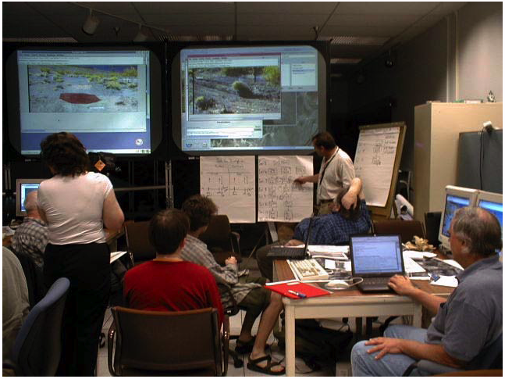
Ethnography (2)
Co-operation of people being observed is required
Informants are useful
Data analysis is continuous
Interpretivist technique
Questions get refined as understanding grows
Reports usually contain examples

Slide 42
Direct observation in a controlled setting
Think-aloud technique
Indirect observation
Diaries
Interaction logs

Slide 43
Choosing and combining techniques
Depends on
The focus of the study
The participants involved
The nature of the technique
The resources available

Slide 44
STYLE PERSONA

Slide 45
Persona’s style
Tidak ada style yang tetap dalam pembuatan persona, namun suatu studi perbandingan tentang style persona telah dilakukan di Denmark(2015), dan menunjukkan style persona sangat dipengaruhi oleh komunitas praktisi, bergantung pada kebutuhan bisnis.
Sumber :
A Template for Design Personas: Analysis of 47 Persona Descriptions from Danish Industries and Organizations,
Lene Nielsen, Kira Storgaard Hansen, Jan Stage and Jane Billestrup
International Journal of Sociotechnology and Knowledge Development (IJSKD), 2015
https://www.igi-global.com/article/a-template-for-design-personas/136351

Slide 46
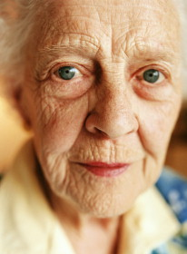
An Example Persona : Marjorie Bannet
Biography
78 years old
Just moved to Penrith from Windermere
Has a son in Hastings, and a daughter in Newcastle
Doesn’t know anyone else in Penrith yet
Hasn’t been driving for a few years now
Sometimes feels lonely
Has a help come in once a week
Would like to be able to read more

Slide 47
An Example: Marjorie Bannet
Health
Has trouble sleeping from time to time. Will wake up in the early hours and often not get to sleep again for 2-3 hours
A little arthritis in her hands
Early cataracts, so less acute vision
Can move about, perhaps not quite as quickly as she could 10 years ago
Sometimes has a rest in the afternoon

Slide 48
An Example: Marjorie Bannet
Technology
Has never used a computer before, and is a little nervous about them
Has a mobile phone, and instructions on how to use it from her son
Uses the microwave to prepare many of her meals
Uses a video recorder, but can’t be bothered setting it to record things

Slide 49
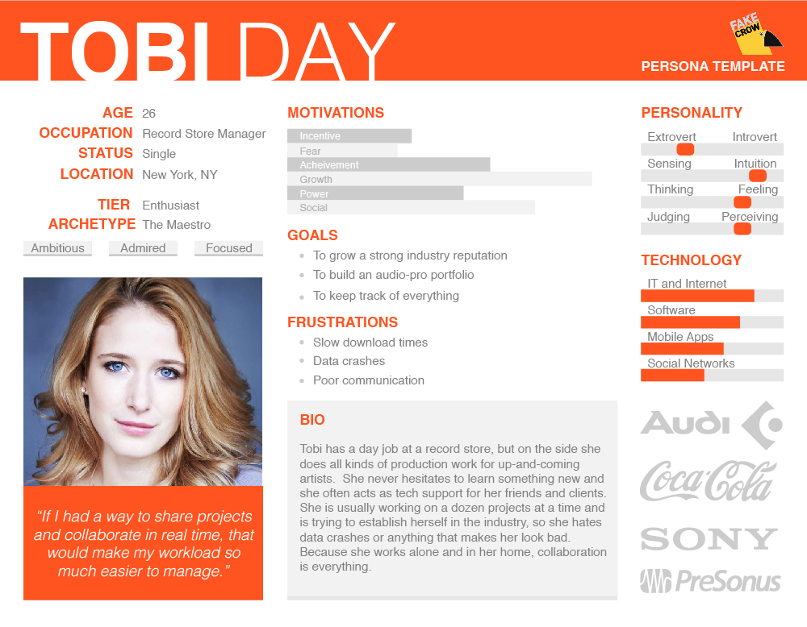
User Persona Example

Slide 50
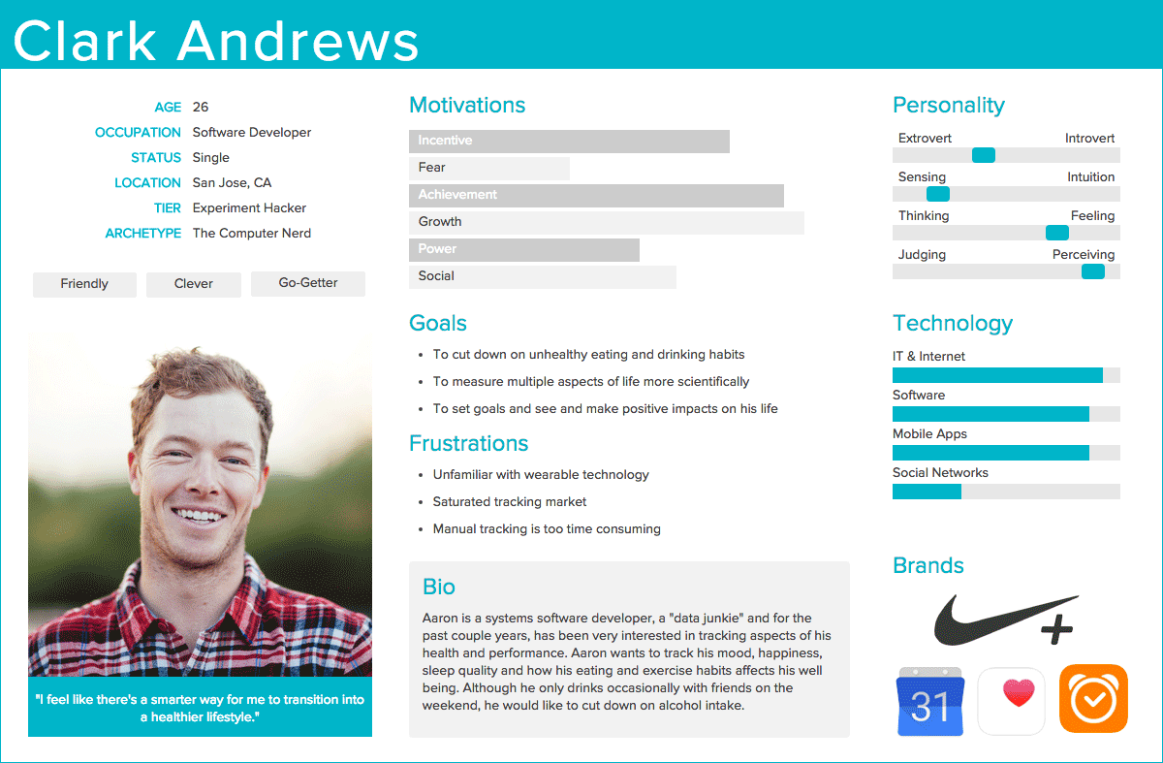
User Persona Example

Slide 51
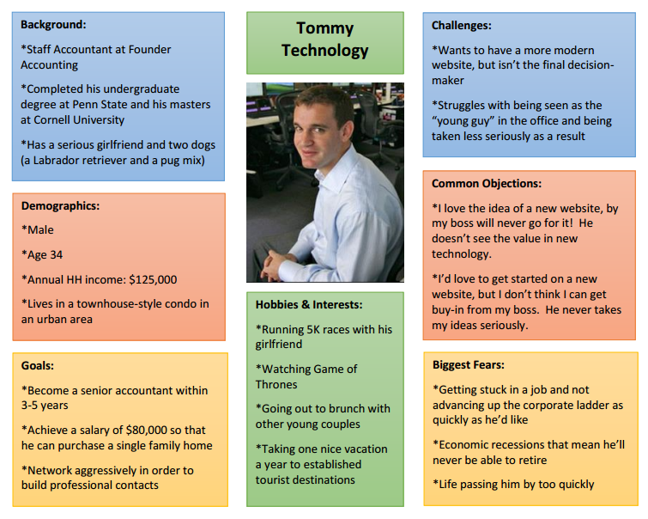
User Persona Example

Slide 52
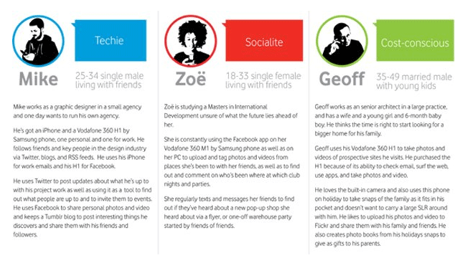
User Persona Example

Slide 53
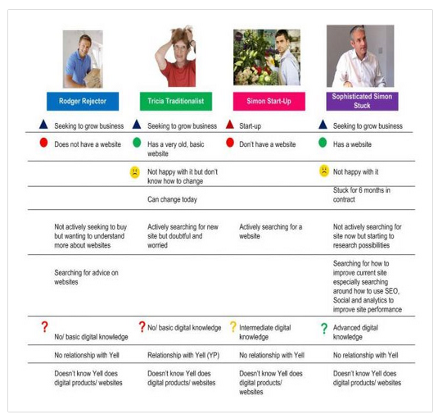
User Persona Example

Slide 54
How to Create User Persona
How To Create UX Personas → https://www.youtube.com/watch?v=B23iWg0koi8
Personas and User Flows UXUI Design Product Design Udacity → https://www.youtube.com/watch?v=wClXAzTFUIY
Creating personas for effective user stories → https://www.youtube.com/watch?v=tCAeHfvsjoM

Slide 55
Template
Tools
http://www.ux-lady.com/diy-user-personas/
https://www.pinterest.com/kooj/personas/
http://xtensio.com/user-persona/
http://grayscale.com.hk/persona-generator/

Slide 56
Bahan bacaan
Wilbert O. Galitz,2007,The Essential Guide to User Interface Design: An Introduction to GUI Design Principles and Techniques, Third Edition, Wiley Publishing, p.71-102 (dan untuk pertemuan minggu depan p.103-126)
https://uxmastery.com/what-does-a-user-centred-design-process-look-like/
http://knowledge.hubspot.com/contacts-user-guide/how-to-create-personas
http://www.smashingmagazine.com/2014/08/a-closer-look-at-personas-part-1/
http://webdesign.tutsplus.com/articles/defining-and-applying-personas-to-ux-design--webdesign-7561
http://www.storyboardthat.com/articles/software-development/using-personas-to-identify-your-target-customers

